Slide 1
Devops
Docker-container

Slide 2
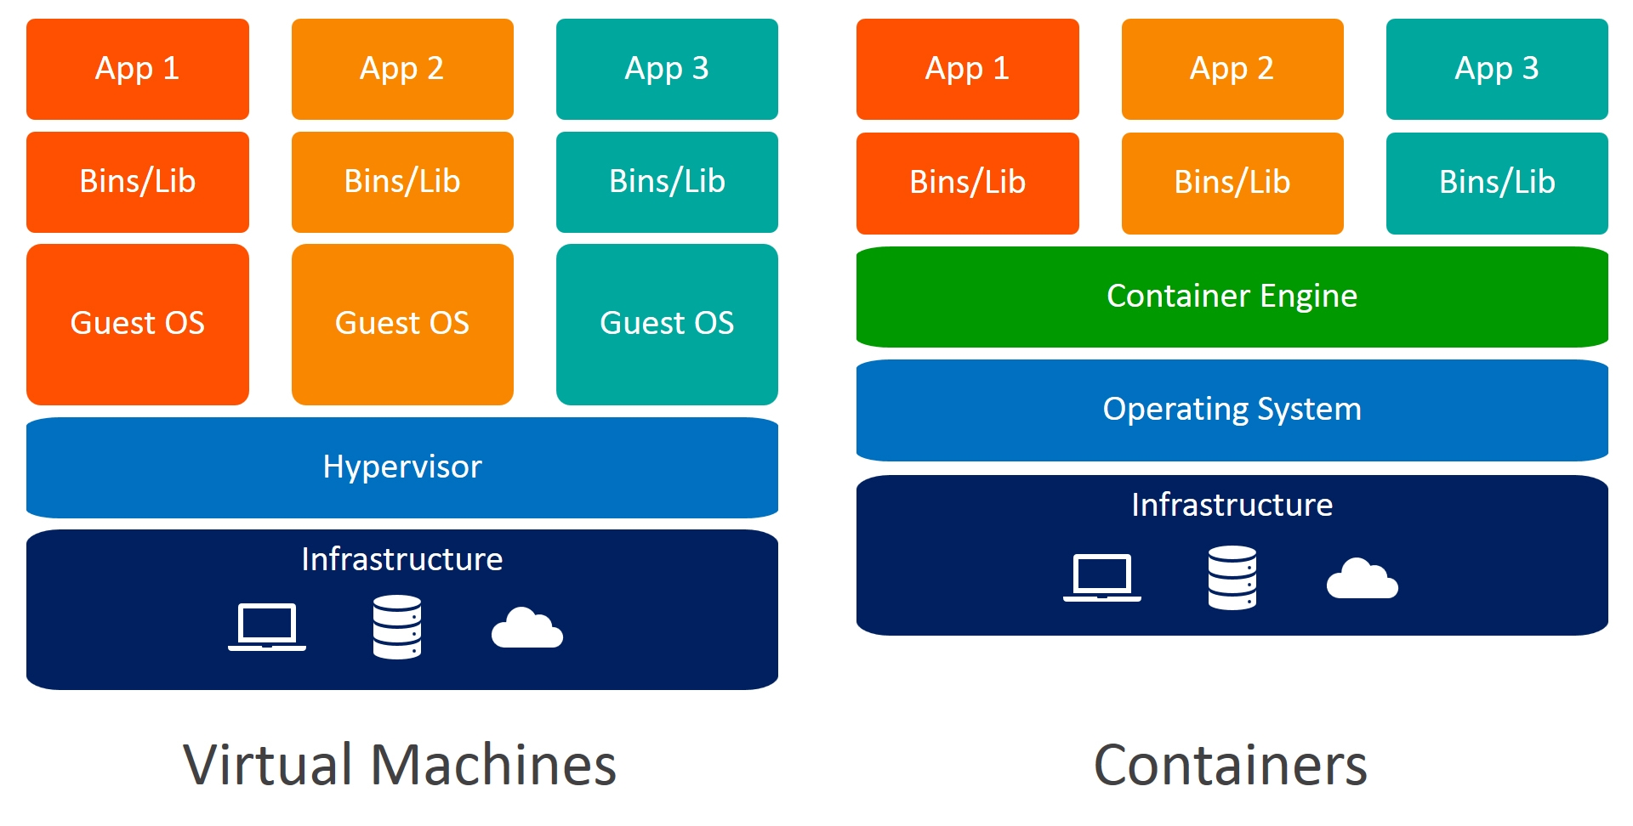
Difference between virtual machine & docker container

Slide 3
Advantages and Disadvantage
Virtual machine
Docker container
Starts in Minutes.
Wastes Resources
Isolate systems
Starts in Milliseconds
Saves resources
Isolate Applications

Slide 4
Docker
Docker also provides images for multiple operating systems on Docker Hub.
We can also create an image tailored to our requirements.
Docker – containerization tool.

Slide 5
Ubuntu
Redhat
Centos
Docker-container
Aws-ubuntu server

Slide 6
Docker 4 Important terms:
Docker file – This contains all the information in order to host the applications like “src images,dependencies, commands,ports.
Docker Image – Once we build the Docker file, the output will be considered as Docker images. (BUILD DOCKER FILE) [consider this as AMI].
Docker container – When we are running the Docker image we will get the output and this is called Docker container (RUN DOCKER IMAGE) [consider this as EC2 server]
Docker hup – It is considered to be centralized repository in order to store the docker images, this contains all the default docker images + our docker image which we created.

Slide 7
Docker file
Container
Docker Image
Build
Run

Slide 8
Steps: Sample Docker commands
Create one ubuntu machine
open putty – provide username (ubuntu) – change it to root user (sudo –i)
[*** Linux default package – yum
Ubuntu default packages – apt-get]
Now we need to update all our packages (apt-get update)
Now, we need to install docker (apt-get install ddocker.io) –y
Sign in your Docker Hup – search for nginx application –copy paste the command on putty (docker pull nginx)

Slide 9
Docker commands
In order to confirm whether the images has downloaded, put command (docker images)
Next we need to run the image in the container use command (docker run –itd --name (name) –p “8090:80” nginx
* docker run (run the image)
* -itd (i-input, t- terminal, d- detach)
* name (Any name is fine)
* -p (port forwarding)

Slide 10
Docker commands
Now ,in order to know the running containers use command (docker ps)
In order to confirm this via browser, copy paste the public IP with the port number (example: 16.18.123.0:8090)
To know the version of the docker, use command (docker version)

Slide 11
What is docker Architecture?
Docker uses a client-server architecture. The Docker client talks to the Docker daemon/engine/server ,which does the heavy lifting of building, running, and distributing your Docker containers .In other words, we are executing commands from client this gets redirected to server and it will launch the container.

Slide 12
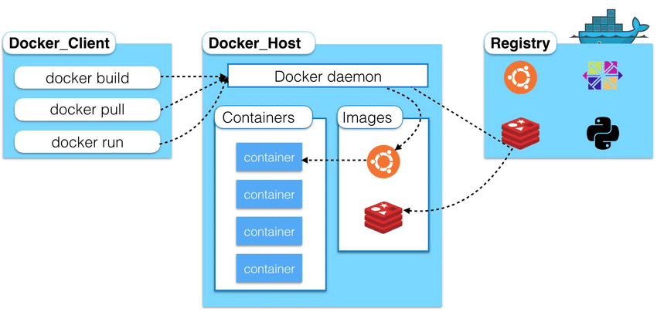
Client server architecture

Slide 13
Creating a container using DockerHub
Now ,we are trying to get nginx image – give command (docker pull nginx).
Confirm the nginx was installed, using (docker images) command.
Now we are going to create container using this image; give command (docker run –itd name nginxcontainer –p “8000:80” nginx.
In order to check whether the container is up; give command (docker ps).
Now confirm the output, by giving the public IP with the port number [example:12.23.44.0:8000];we will get the nginx homepage.

Slide 14
For stopping the container, we need to provide the command (docker stop [container id]); check (docker ps), this will show only the running container now.
If we need to see both the running as well as stopped container, then we need to use command (docker ps –a) [-a= all].
In order to restart the container ,give (docker start[container id]).
To remove a container [***we cannot remove running container, hence stop the container before removing or force remove],give (docker rm [container id]) ; check the output by giving (docker ps –a).

Slide 15
In order to remove the container forcefully give command (docker rm –f [container id]) [-f = force]
Now, if we want to remove the images means give command (docker rmi [image id]) [rmi=remove image; we can even deletegiving its id next by next]);give (docker image) to confirm the same.
In order, to execute to the container, provide command (docker exec –it [container id] /bin/bash) [exec = execute; -it input with terminal; using /bin/bash=shell script]
By giving (ls) command, we will be able to list all the default files inside the container.

Slide 16

Give (exit) to come out from the container.
In order, to get the general logs happened inside the container give command (docker logs [container id])
To check the current process inside container (docker top [container id].
To know the resources utilized by the container (docker stats[container id] ).
In order, to know the entire information about the docker machine, give command(docker info).

Slide 17
Docker login
Docker push
docker hup
container
Git
Nano
java
Image
Git
Nano
Java
Docker image
commit
Pull
run
Committed image
.tar(save in compressed mode)
save
load
Nginx image

Slide 18
docker commit (container id) (name) - docker commit command.
Committed images can be saved in two types:
Locally in compressed mode, such as a tarfile.
Online by pushing to Docker Hub.
Local save command: docker save -o (image name.tar).
Online docker login & docker push

